Slide 1
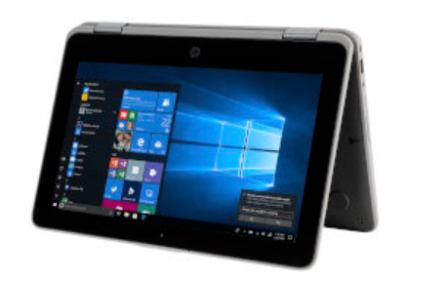
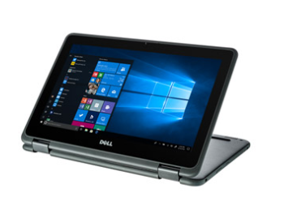
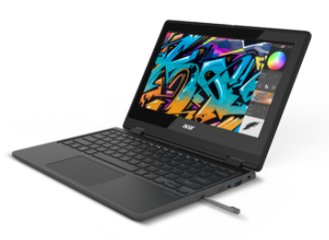
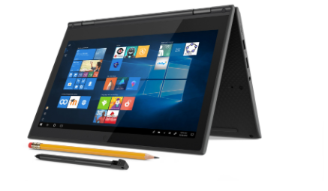
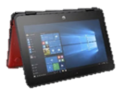
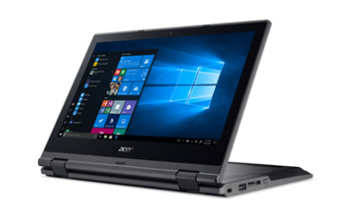
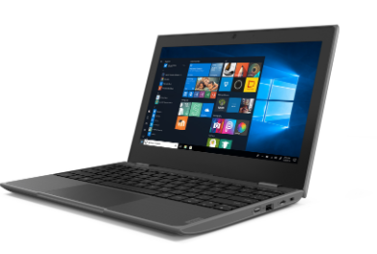
Windows Education Devices Portfolio
Business-like productivity for the most demanding work
The best devices for the hardest job in the business, higher end performance and innovative features to help create and deliver the content. Starting at $399 (ERP) and up.
Key Usage Scenarios
Advanced STEM applications with more demanding processing needs. Also for teachers and administrative staff scenarios, where more performance is needed and time is limited.
HP x360 11 EE
11.6” 4/500GB
Starting at $319
Dell Latitude 3190 2in1
11.6 4/64GB
Est $299
Acer Travelmate Spin B3
11.6 4/64GB
Starting at $329
Built for what any school day can throw at them
Purpose built for education with features ranging from rugged designs and multi-mode to precision pen & inking. Starting at $279 (ERP) and up.
Key Usage Scenarios
Shared device and mobile cart scenarios in K-12 education with multiple user accounts per device and support for the full ecosystem of Windows applications. Great device for STEM and collaboration scenarios.
Good
Better
Best
Lenovo 300e 2nd Gen
11.6” 4/64GB
Starting at $299
Dell Latitude 3190
11.6” 4/64GB
Starting at $329
Acer TMB Spin B118
11.6” 4/64GB
Starting at $299
HP ProBook X360 G3 EE
11.6” 4/64GB
Starting at $319
Built for the cloud, works great offline
Full-featured Windows devices optimized for the cloud that also offer great offline productivity powered by Windows Store apps, all starting at around $189 (ERP).
Key Usage Scenarios
1:1 deployments in K-12 education leveraging the Microsoft cloud and the wide range of Windows Store apps and Microsoft Office apps.
Lenovo 100e 2nd Gen
11.6”4/64GB
Starting at $219
HP Stream
11 PRO G5
11.6” 4/64GB
Starting at $219
Dell Latitude 3310
13.3” 4/64GB
Starting at $299
Acer TravelMate B118(M)
11.6” 4/64GB
Starting at $219
All prices shown are estimated prices
* Specs and Features are guidelines only. Refer to actual manufacturer’s product specification for specifics.

