Slide 1
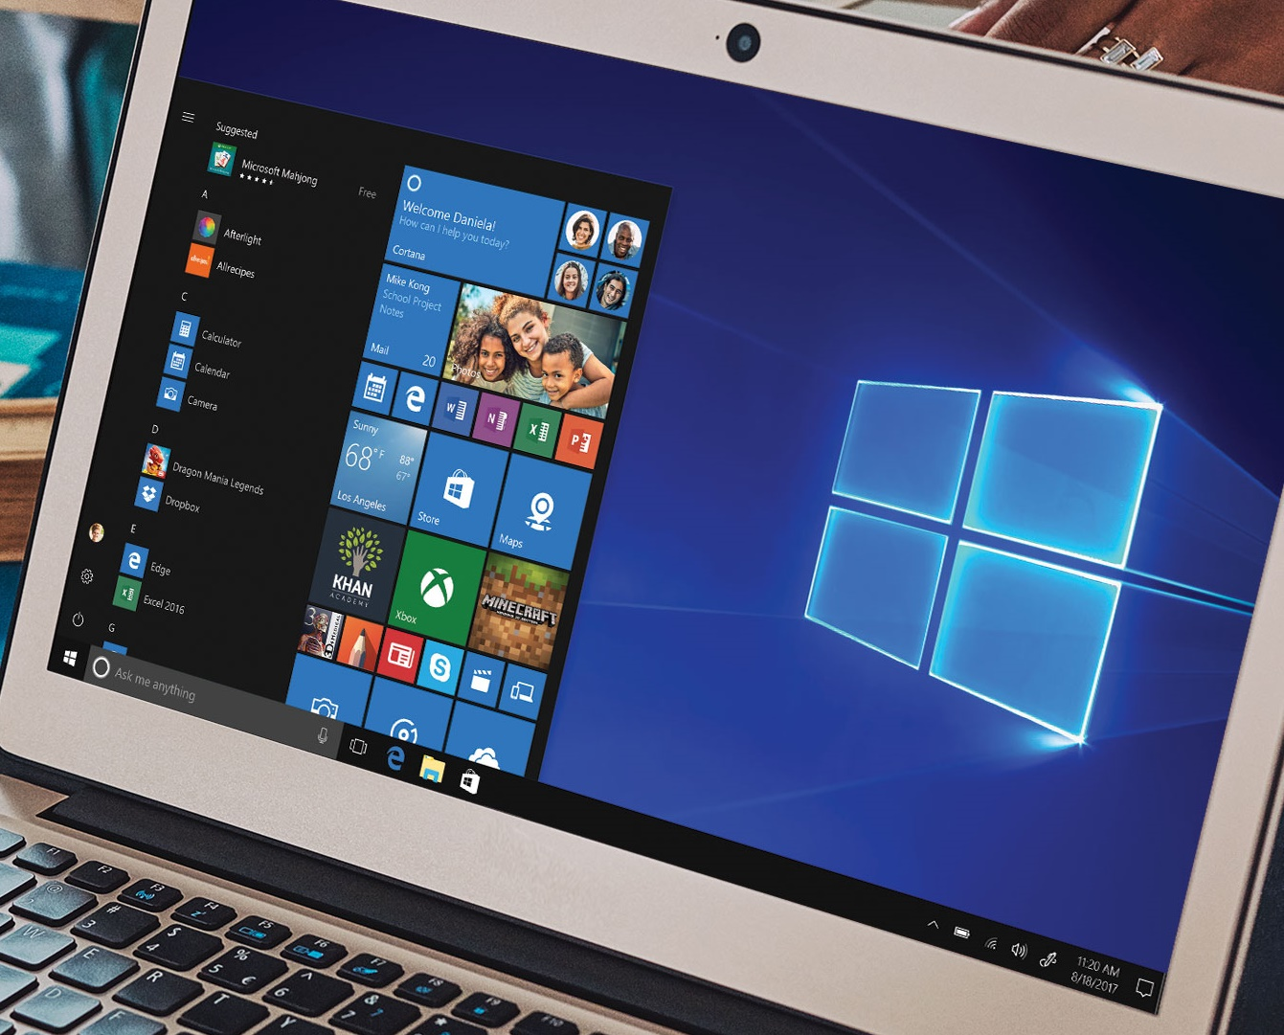
Streamlined for security and speed
Introducing Windows 10 S – built to work with Microsoft Education
Tested for security uses only Microsoft-verified apps, for superior security levels day in and day out
Performance that lasts streamlined and simplified to run faster and longer
Familiar Windows features on a range of devices gives schools the familiar, robust and productive experiences they expect
Cloud convenience plus the power of apps combines the speed and convenience of the cloud with full-featured apps
Easy to deploy and manage side-by-side with other versions of Windows
Schools can switch free to Windows 10 Pro Education
Run fully-installed Office applications
Windows 10 S devices configurable for educational use by applying SetEduPolicies.
Notes:
Tested for security Windows 10 S uses only Microsoft-verified apps, for superior security levels day in and day out
Performance that lasts streamlined and simplified to run faster and longer
Familiar Windows features on a range of modern devices Gives schools the familiar, robust and productive experiences they expect
Cloud convenience plus the power of apps Combines the speed and convenience of the cloud with full-featured apps
Easy to deploy and manage side-by-side with other versions of Windows
Schools can switch free to Windows 10 Pro Education
Run fully-installed Office applications on Windows 10 S

Slide 2
 | Home | S | Pro / Pro Education | Enterprise / Education
Start Menu / Hello / Cortana / Windows Ink / Microsoft Edge | ● | ● | ● | ●
Store apps (including Windows desktop bridge apps) | ● | ● | ● | ●
Windows Update | ● | ● | ● | ●
Device Encryption | ● | ● | ● | ●
Mobile Application Management | ● | ● | ● | ●
Windows Update for Business |  | ● | ● | ●
Microsoft Store for Education |  | ● | ● | ●
Mobile Device Management and Azure AD join |  | ● | ● | ●
Windows Information Protection |  | ● | ● | ●
BitLocker |  | ● | ● | ●
Desktop (Windows 32) Apps | ● |  | ● | ●
Change App Defaults (Search/Browser/Photos/etc.) | ● |  | ● | ●
Active Directory Join |  |  | ● | ●
Credential Guard |  |  |  | ●
Device Guard |  |  |  | ●
Windows 10 S
Quick facts
Works great with Microsoft Education
Gives schools cloud-connected access to Office 365 for Education, OneDrive and resources via Azure Active Directory
Use side-by-side other editions of Windows 10
Easy to deploy, manage and use side by side other editions of Windows 10 in the classroom
Switch free to Windows 10 Pro Education
Education customers can switch free to Windows 10 Pro Education using the Microsoft Store for Education across their entire tenant or using MAK keys to target individual devices
Shipping in summer
Windows 10 S devices will begin shipping in summer 2017

Slide 3
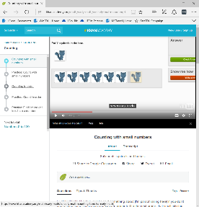
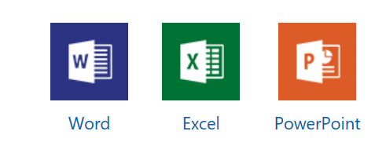
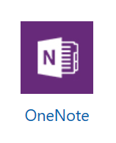
Windows 10 S in Education
Usage Scenarios
Fast, secure access to the Web
For Office collaboration
In labs for Store apps
For students who use the PC to primarily access the Web
For shared carts where students collaborate in Office
For fast & easy access to Store Apps like Minecraft: Education Edition
Arduino IDE
Lego Education WeDo 2.0
Notes:
Explain 3 scenarios in Education where expect to see Windows 10 devices used.
Highlight the opportunity for devices used primarily for Microsoft Edge, Office applications and Store apps

