Slide 1
The Cost of Doing Nothing:
Windows 10 Pro Device Refresh Sales Guide
HOW TO USE THIS GUIDE
Use this guide to engage midsize business customers in a conversation regarding the risks of using outdated devices and the benefits of Windows 10 Pro on new devices.
Your discussion should be customized based on the situation, but the general flow is outlined here:
1
2
3
4
Start
the conversation by reviewing the risks of old hardware
Explain
why it’s time to refresh with new Windows 10 Pro devices
Talk
about the choice among business devices with Windows 10 Pro
Discuss
the value of Microsoft Office on a Windows device
Windows 10 Pro the Cost of Doing Nothing – Sales Guide for Microsoft and Partner use only

Slide 2
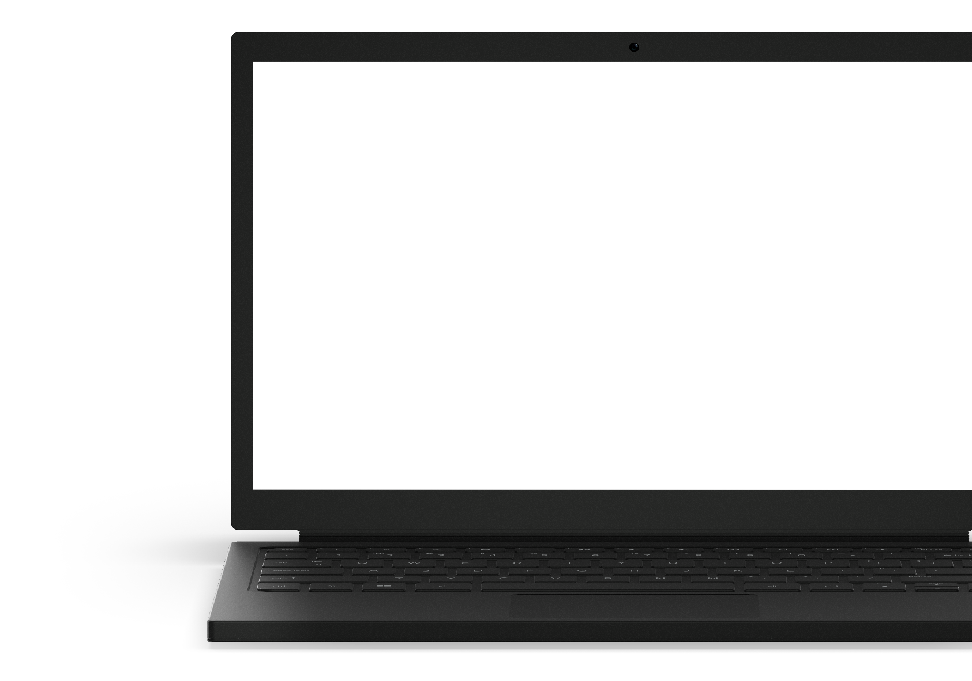
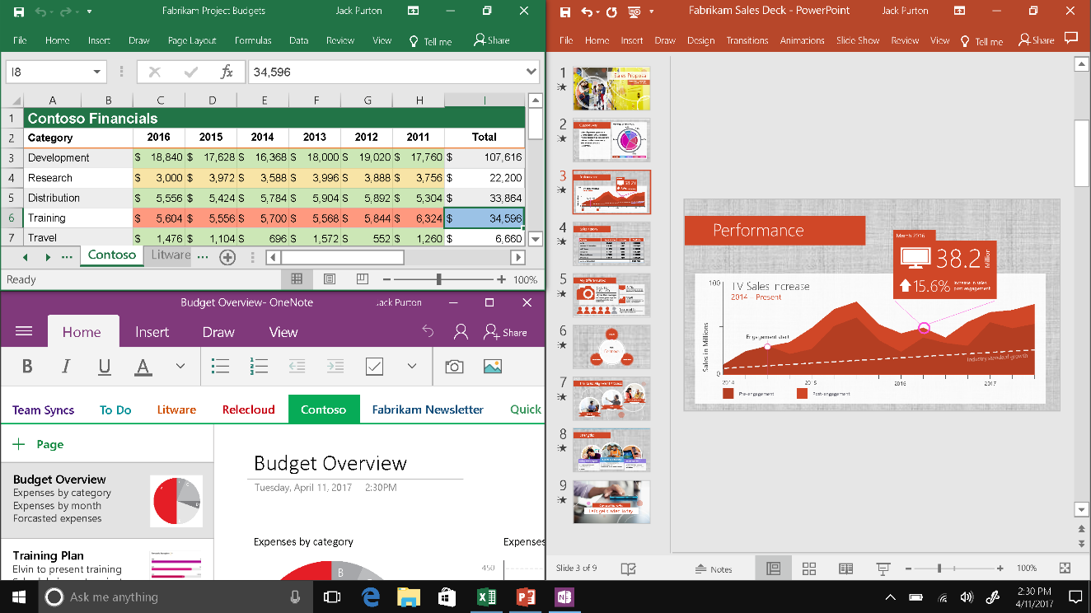
the business risks of old devices
1
Start the conversation by reviewing the risks of old devices. Encourage the customer to think about the real costs of their current older hardware: less security, more repairs, and lost productivity. Probe to understand the customer’s pain points.
GOAL: Persuade the customer they should refresh their devices.
Cost your business more
PCs older than 4 years can cost 1.5x more in repairs and, on average, an additional $426/year in total maintenance costs.¹
Decrease productivity
A PC just older than 4 years is 200% more likely to be repaired, resulting in 48 hours of time lost in productive hours.¹ Not to mention, older PCs can only run about 5 applications simultaneously without performance degradation, while newer PCs can easily run 8 or more.¹
Limit performance
Windows 10 devices have up to 2.5x better performance,² 3x longer battery life,³ and wake up from sleep mode 4x faster⁴ than a 5-year-old Windows laptop.
Put your business at risk
More than 50% of small businesses have suffered a data breach or cyberattack,⁵ averaging more than US $84,000 per breach.⁶ Hardware-enabled features in modern PCs help you be more secure from power on to power off. For example, technologies like UEFI (Unified Extensible Firmware Interface) and ELAM (Early Load Anti-Malware) make sure only healthy, certified programs can start during the boot process.⁷
“Windows 7 works fine for us.” Why move to Windows 10? With Windows 10, you get the familiar yet improved desktop and Start Menu as well as features such as the Cortana personal digital assistant,† Live Tiles, and Continuum, OneDrive cloud storage integration, improved support for touch, pen and voice,‡ plus overall better performance which will enable you to be up to 25% more productive than ever.⁶ And that’s not to mention the hardware costs of an older device. Plus, you get hardware- and software-enabled features that help protect your devices and company information from ever-evolving security threats.
“If Windows 10 will run on our current devices, why do I want new ones?” If you run Windows 10 on your current devices, you may be missing out on all the benefits and features that Windows 10 has to offer. The total cost of owning a four-year-old PC can cost US $1,774.¹ A new Windows 10 device boot up is on average 28% faster than Windows 7,⁷ and devices with 6th Gen Intel® Core™ processors have up to 2.5x better performance,² up to 3X longer battery life,³ and wake up from sleep mode up to 4X faster⁴ than a 5-year old Windows laptop. A new device with the appropriate hardware features will also enable you take better advantage of touch- and pen-friendly‡ Windows 10, including new features such as Windows Hello* and the Cortana† personal digital assistant.
¹Small Business PC Study, Techaisle, 2016. ²Performance of 6th Gen Intel® Core™ processors in Windows 10 devices, based on measured SYSmark 2014. ³Comparisons based on Intel® Core™ i5-6200U vs. Intel® Core™ i5-520UM. ⁴Performance of 6th Gen Intel® Core™ processors in Windows 10 devices, measured wake time for 5-year-old system vs. estimated Modern Standby Wake Time, Comparisons based on Intel® Core™ i5-6200U vs. Intel® Core™ i5-520UM. ⁵Ponemon; 2016 State of Cybersecurity in SMB (USA); Canadian Chamber of Commerce, An Analysis of the Adoption of Internet-based Technology, February 2017. ⁶Small Biz Daily: 10 Small Business Trends 2018. ⁷Testing conducted by Principled Technologies in July 2015 in a closed lab environment using OEM factory default images on a representative sample of Windows 7 devices. Each boot test was run 10 times and the averages compared. Average improvement in startup was 28%. ‡Hardware dependent *Windows Hello requires specialized biometric hardware. †Cortana available in select markets; experience may vary by region and device.

Slide 3
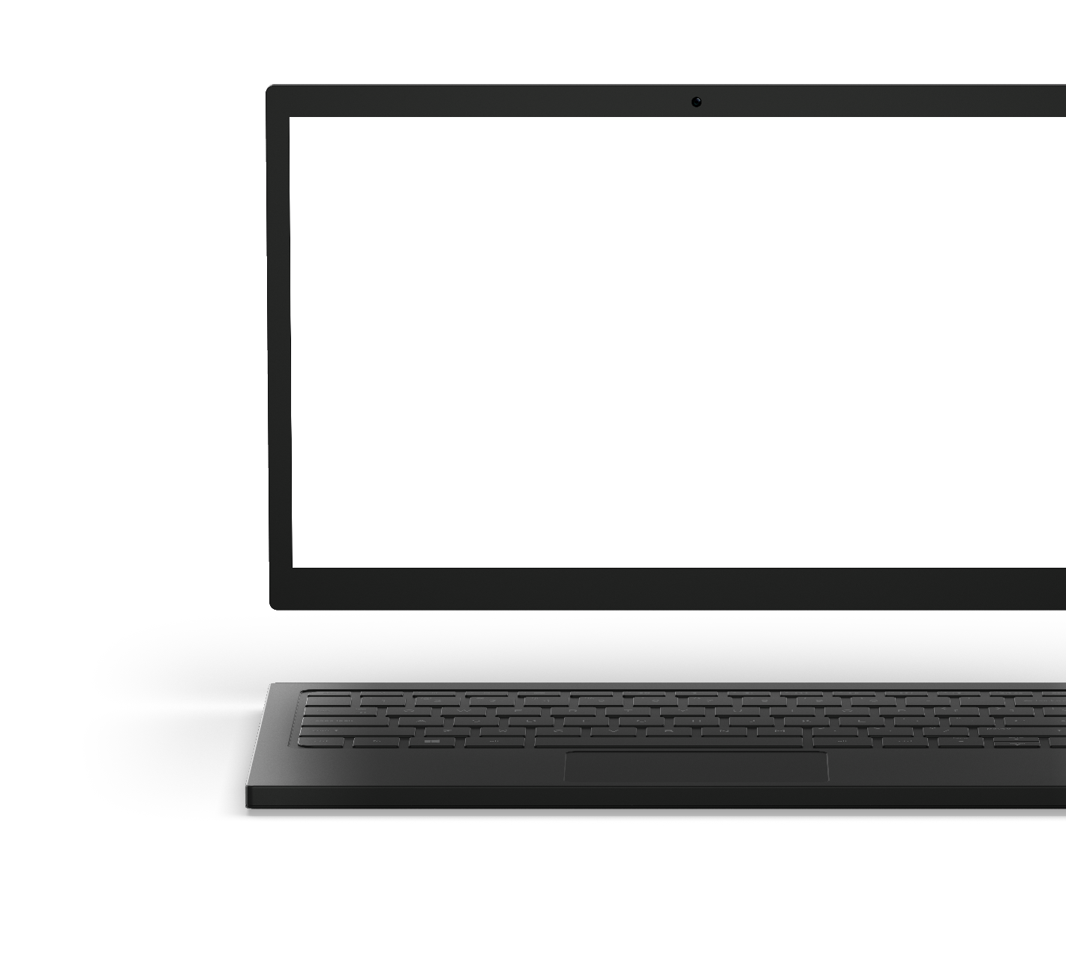
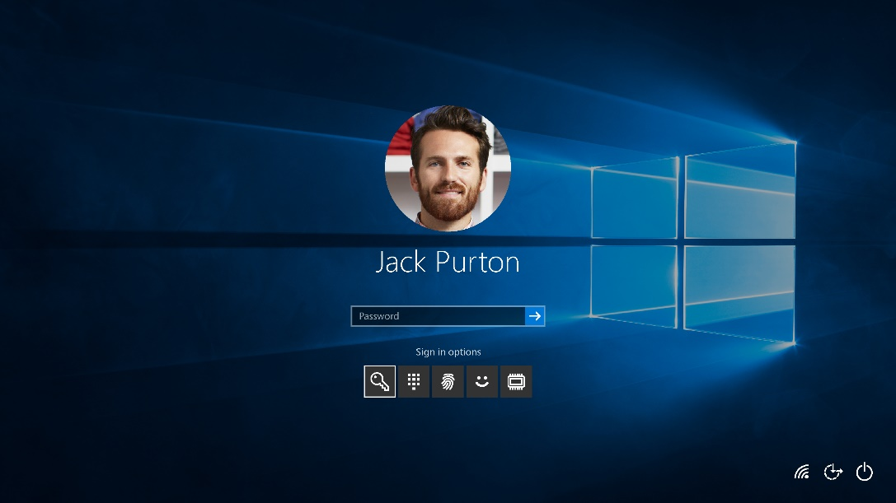
Benefits of new Windows 10 PRO devices WITH INTEL® Core™ vPro™ processors
2
Explain why the customer should buy new devices. Based on your understanding of the customer’s concerns, you can emphasize security, performance, management, and/or selection.
GOAL: Motivate the customer to choose to purchase new Windows 10 Pro devices.
Get more done. With Windows 10, new 8th Gen Intel® Core ™ vPro™ processor-based devices provide up to 2.1 times faster multi-tasking for seamless performance when working with applications simultaneously.¹ And Windows 10 Pro devices help you do more in ways older devices cannot.
Use your laptop like a tablet or your tablet like a laptop with Tablet Mode²
Interact with your device however you want, with voice, gesture, pen, touch, or keyboard and mouse²
Capture notes at the speed of thought without being logged in,³ using Windows Inking²
Start faster and keep working longer with speedier wake up, faster processing speeds, and a long-lasting battery
Get going right away, thanks to a familiar operating system such as the Start menu and Live tiles
Use Cortana⁴ at work, your digital assistant to help you be more efficient
Express ideas in all dimensions with Paint 3D
Protect what you’ve built. Security events requiring IT remediation are reduced or avoided by up to 33% with Windows 10.⁵ Windows 10 Pro has built-in defenses against modern security threats and always-up-to-date protections⁶ for your information and device, no matter where you or your team work.
Sign in with your face or your fingerprint with Windows Hello⁷
Get protection against business information loss even when a device is lost or stolen with BitLocker and Bitlocker To Go
Prevent unauthorized business information sharing with Windows Information Protection⁸
Help safeguard against modern malware threats with Windows Defender Antivirus
Simple and flexible management. Thanks to user-friendly and flexible management, IT administrators estimate a 20% reduction in IT desktop management time with Windows 10.⁹
Users can set up new devices quickly on their own with Windows AutoPilot
Sign in once for all Microsoft services and many apps on Azure, using Azure Active Directory
Receive updates on your own schedule with Windows Update for Business
Acquire, manage and distribute apps easily using the Microsoft Store
Compatible with your apps and peripherals
“Will I have to get new apps and new peripherals (printers, cameras, etc.) if I use a new device?” According to our data, 99%¹⁰ of Windows 7 apps are compatible with Windows 10. Windows 10 Pro devices are compatible with most apps and with most peripherals, both wired and wireless. We can help you confirm compatibility.
“New devices are too expensive.” Maintaining old devices is more expensive than you may realize. In fact, owning a four-year-old PC can cost US $1,774.⁹ New business devices are available in a wide range of prices as well as styles to fit every member of your team. We can help you find one that fits your needs and budget.
“I don’t want to start all over with our infrastructure.” Windows 10 Pro builds on the network you already have in place, and allows you to expand and enforce user and group policies.
¹As measured by an overall score of SYSmark* 2014 vs. a 4-year-old commercial PC. Software and workloads used in performance tests may have been optimized for performance only on Intel microprocessors. Performance tests, such as SYSmark and MobileMark, are measured using specific computer systems, components, software, operations and functions. Any change to any of those factors may cause the results to vary. You should consult other information and performance tests to assist you in fully evaluating your contemplated purchases, including the performance of that product when combined with other products. For more complete information visit www.intel.com/benchmarks. The benchmark results reported above may need to be revised as additional testing is conducted. The results depend on the specific platform configurations and workloads utilized in the testing, and may not be applicable to any particular user’s components, computer system or workloads. The results are not necessarily representative of other benchmarks and other benchmark results may show greater or lesser impact from mitigations. to any particular user’s components). ²Device dependent. ³User must enable settings. ⁴Cortana available in select markets; experience may vary by region and device. ⁵Forrester, The Total Economic Impact™ of Microsoft Windows 10. ⁶For the supported lifetime of the device. ⁷Windows Hello requires specialized biometric hardware. ⁸Windows Information Protection requires either Mobile Device Management (MDM) or System Center Configuration Manager to manage settings. These products sold separately. Active Directory makes management easier, but is not required. ⁹Small Business PC Study, Techaisle, 2016. ¹⁰Hardware/software requirements apply; feature availability may vary. Internet connection required. To check for compatibility and other important installation information, visit your device manufacturer’s website and www.windows.com/windows10specs. Additional requirements may apply over time for updates.

Slide 4
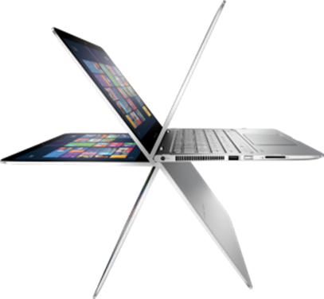
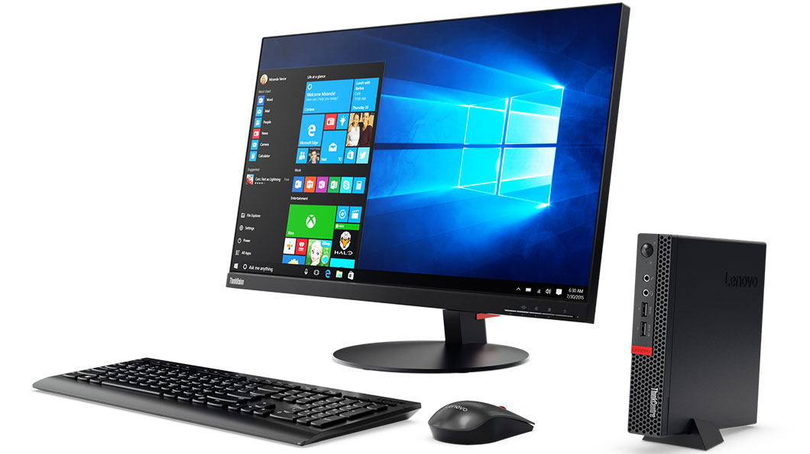
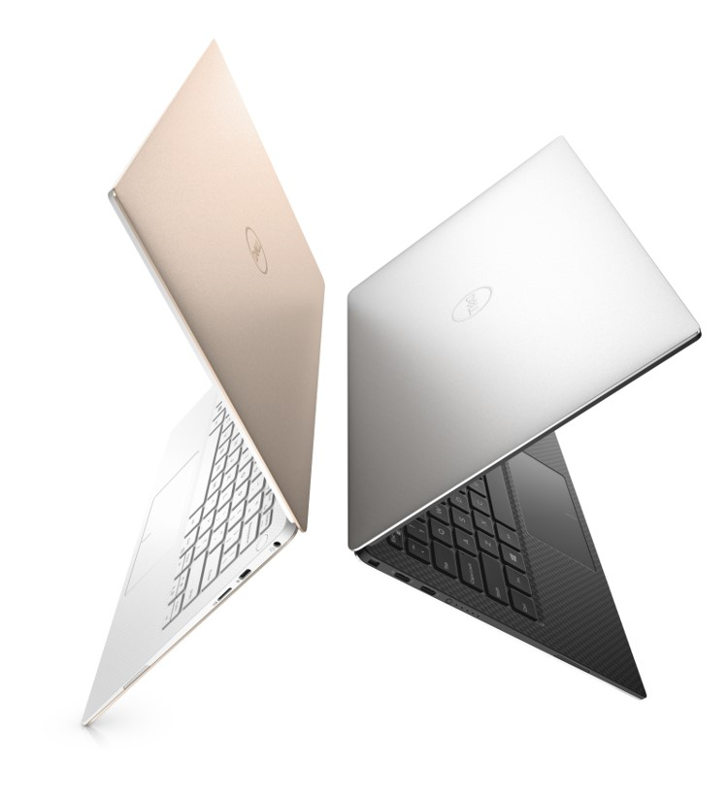
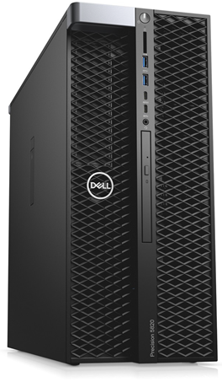
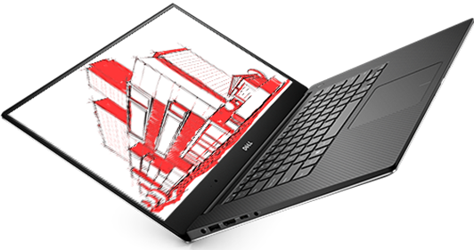
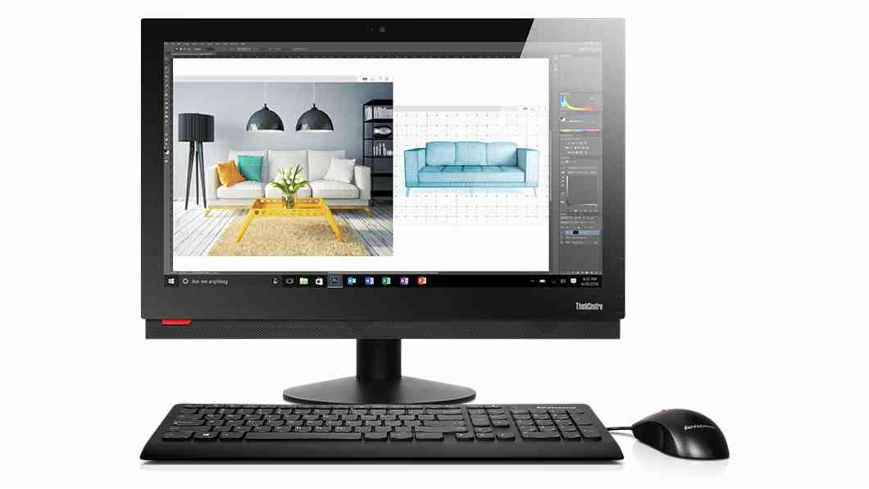
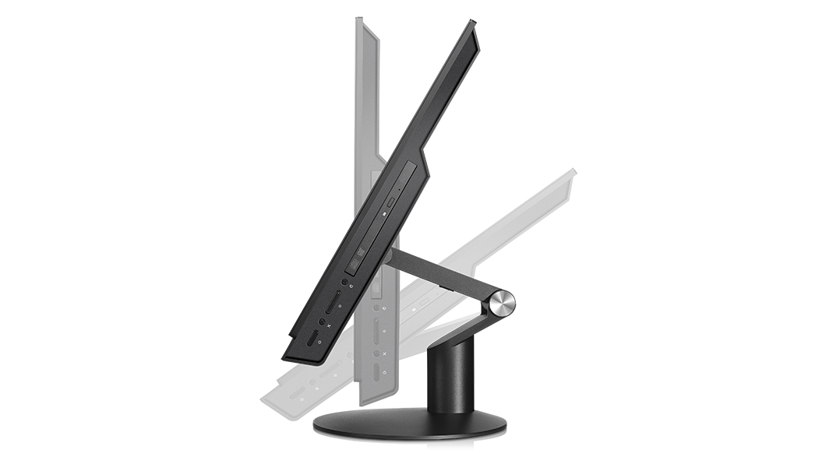
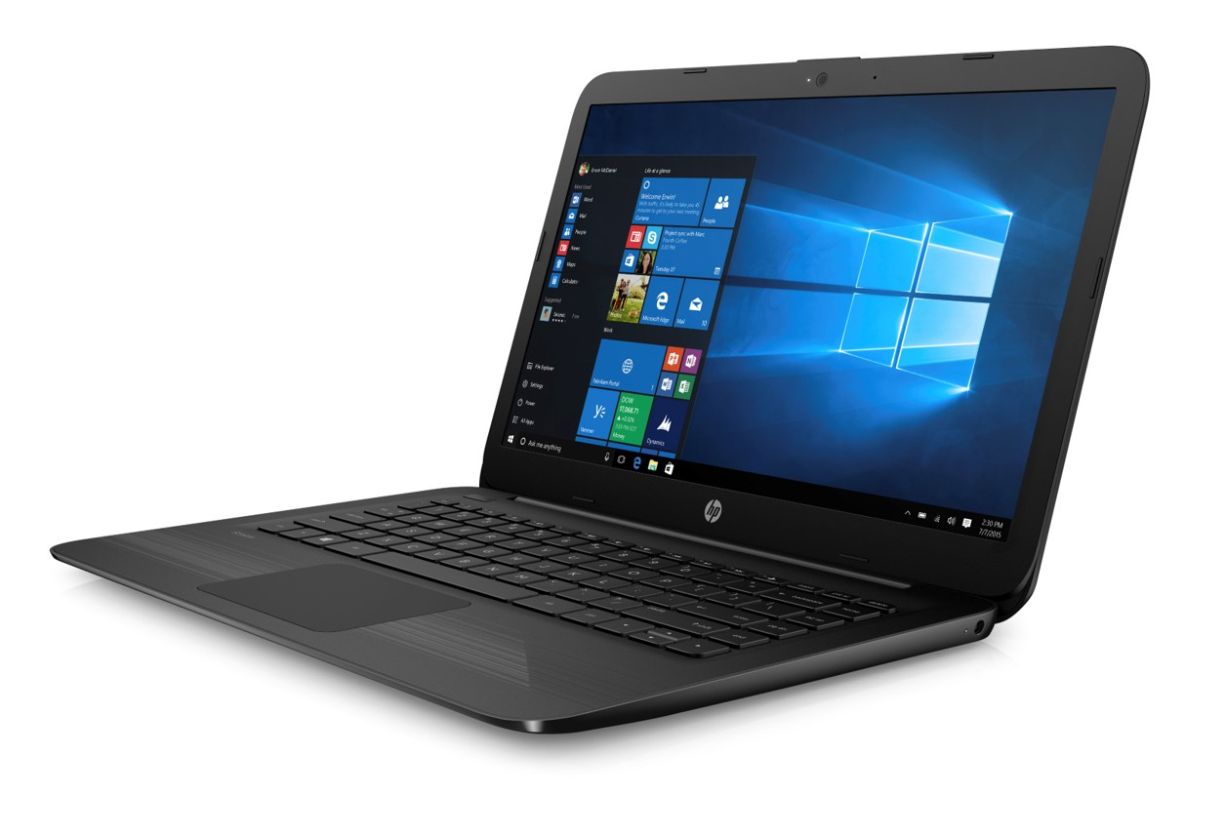
CHOOSE THE RIGHT WINDOWS 10 PRO DEVICE
3
Help the customer choose the right Windows 10 Pro devices. Users can choose among a wide choice of form factors, price points, and capabilities to get exactly the right device for each member of their team.
GOAL: Encourage the customer to choose new Windows 10 Pro devices. Note to partner: customize with your URL.
2-in-1
Switch easily from tablet to laptop—and back. Best for mobile workforces & employees that will benefit from a multi-formfactor experience.
HP Elitebook x360
Mini Desktop
Managers and executives will appreciate so much computing power in such a small package. Small enough to mount on the back of a monitor, sit on a desk, and easy to take on the go when needed.
Lenovo m910 tiny x
Ultraslim Laptop
This professional, powerful laptop has a big, touchscreen. Available at multiple price points for a wide range of office & mobile workers
Dell XPS 13 Commercial
Workstation
Data- and compute-intensive professionals, such as creatives, data scientists, and computer aided designers (CAD), can power through advanced workloads.
Dell Precision Tower & Mobile Workstations
All-in-One
Compact all in ones are great for customer facing scenarios that need powerful, dependable experience with a sleek appearance. Available in touch & adjustable stands to enable the ultra intuitive experience.
Lenovo M910Z
"Slim" Devices
Affordable with reliable security features your company needs. Best for frontline & task workers that often share devices.
HP Stream 14

Slide 5
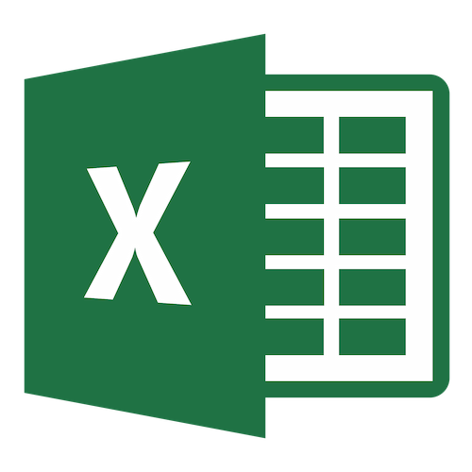
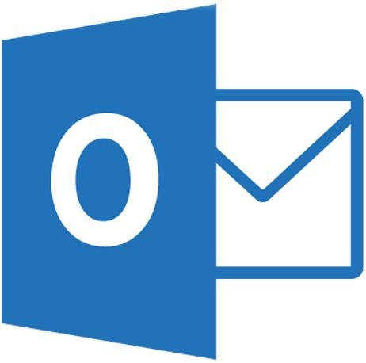
add office. It Takes the Work out of Working Together.
4
Discuss the value of Office on a Windows 10 Pro device. Office is perfect for Windows 10. Grow and transform your business with a modern device running Windows 10 and Office. Now, you can easily manage updates and get extra security to protect your system and data.
GOAL: Upsell Office on top of device purchase.
Empower your team, safeguard your business, and simplify IT management with a single solution, purpose-built for your business.
Modern desktop productivity. Keep your small business on task with smart productivity features that help you do great work more quickly.
Do great work anywhere, anytime. Be productive at your convenience when you can get work done from anywhere, at any time, with easy access to the files in the cloud.
Made for teamwork. Get your team on the same page—share, present, and work together with simplified, built-in collaboration tools.
What’s Included
Create, polish, and share beautiful documents with Word
Excel Analyze and visualize your data in new and intuitive ways with Excel
Create, collaborate, and effectively present your ideas with PowerPoint
Harness your thoughts in your very own digital notebook with OneNote
Never miss important messages or meetings with an upgraded inbox and calendar in Outlook
TOP FEATURES
Tell Me is a powerful new feature in Office that will guide you to the results you are looking for.
Smart Lookup. Powered by Bing, finds you contextual information from the web within the desktop applications.
One-click Forecasting. Don’t spend hours assessing historical data when you can predict future trends in one click.
Modern attachments. Files can be easily shared, wherever they are, right from Outlook.
Co-author** in Word and PowerPoint. Real-time typing in Word lets you see others’ edits as they make them.
Partner: use this space to add information on your Office offerings – should include Office 365 & On Prem
*Separate subscription required. **Co-authors must be using Office 2016 or Office Online.

