Slide 1
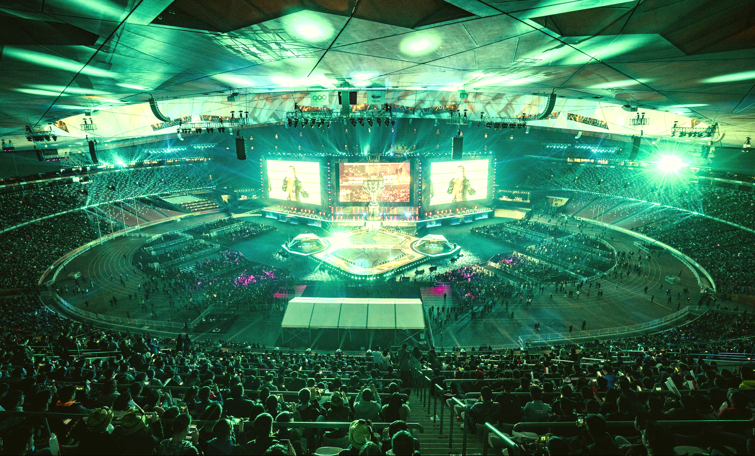
ESPORTS IS THE NEW SPORTS
500M
Esports Viewers
Worldwide
100M
League of Legends Worlds Viewers
1.3M
NASCAR iRacing
Viewers
75%
GeForce Gamers Play Esports

Slide 2
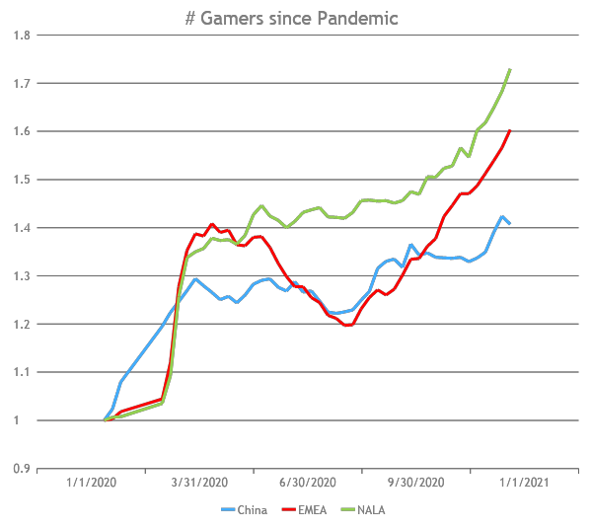
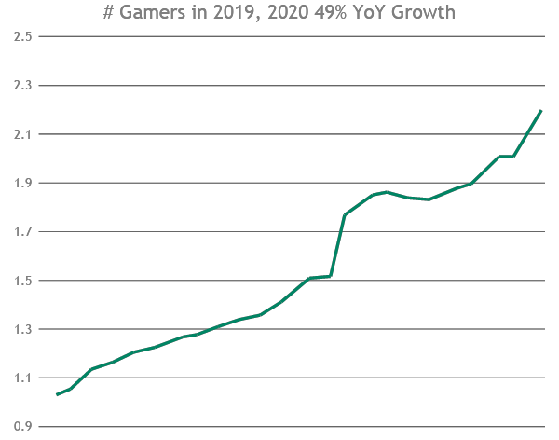
# OF ACTIVE GAMERS CONTINUES TO GROW
Source: NVIDIA

Slide 3
MILLIONS OF PEOPLE TURNING TO GAMING
STEAM
Avg. Concurrent Users
DISCORD
Monthly Active Users
YOUTUBE
Hours of Gaming Watched
ESPORTS
Global Audience
25M
140M
100B
495M
395M
12M
56M
50B
2018
2020
2018
2020
2018
2020
2018
2020
Notes:
DISCORD Monthly Active Users
2018 56M
2020 140M
STEAM - Avg Concurrent Users
2018 11.6M
2020 24.8M
YOUTUBE - Hours of Gaming Watched
2018 50B
2020 100B
ESPORTS – Worldwide audience
2018 395
2020 495

Slide 4
THE FASTEST GROWING GAMING PLATFORM
7x
In 7 Years
50 Million
GeForce Laptop Gamers
14 Billion
Hours Played

